Slide 1
Collaborating with git
Eric Pedersen
DFO R workshop Series
January 18, 2018

Slide 2
What we’ve previously covered:
Using git as a lab book for your code
Creating git repositories
Staging and committing files
Viewing and understanding git history
Using git from the command line and Sourcetree

Slide 3
What we’ll cover today:
Basic ideas about collaborating with git
branches, push, fetch, pull
Creating remote repositories
bare versus working repositories and how to clone remote repositories
Collaborating via Github
Common errors and what to do about them

Slide 4
To start: practicing what we’ve previously covered
Start up Sourcetree now
We’ll work through the following steps:
Create a new repository using Sourcetree
Create a new text file in that repository and add text
Add that file to the stage and commit your changes
View the history of commits you’ve made

Slide 5
Branches
Used to test new ideas without changing your main analysis
A1CD4B
“developed
model”
86AB17
“Added line plots to assessment”
1476B5
“Generated predictions”
EF35B2
“made line plot of
predictions”
34A3E9
“Created histogram of predictions”
86AB17
“Added histogram to assessment”
Notes:
Following this: demo how to create a branch in the live repository

Slide 6
Working with remote repositories (how do you collaborate with git?)
Shared folder
(or Github)
Your collaborator’s
computer
Your computer
Your local repository
Remote repository
Their local repository

Slide 7
Working with remote repositories (how do you collaborate with git?)
push
Fetch/pull
Your local repository
Remote repository
Their local repository

Slide 8
Working with remote repositories (how do you collaborate with git?)
push
fetch + pull
push
fetch + pull
Your local repository
Remote repository
Their local repository

Slide 9
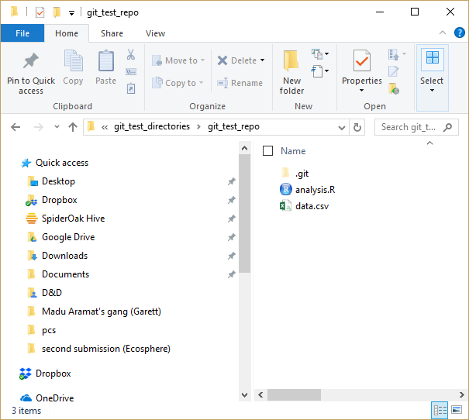
Working versus bare repositories
Working repository
What you use when keeping track of changes
Has both git history and files you’re working on

Slide 10
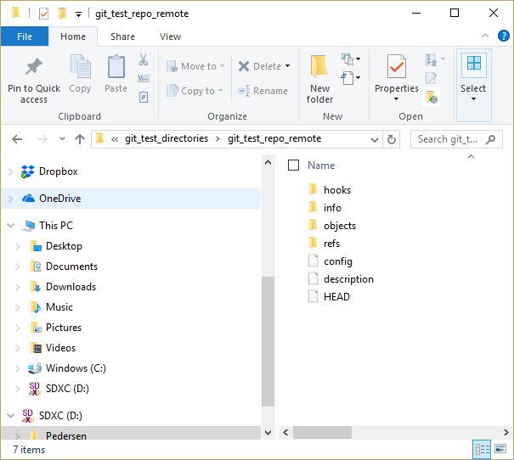
Working versus bare repositories
Bare repository
Acts as a remote repository to connect users
Only has the git history in it
initialize one with:
git init --bare “directory_name”

Slide 11
Git workflow to create a collaboration on a shared drive
1. Create folder, and initialize it as a bare repository
git init --bare “remote_name”
Your local repository
Remote repository
Their local repository

Slide 12
Git workflow to create a collaboration on a shared drive
2. Add that bare repository as a remote on your local
git remote add origin “remote_name”
Your local repository
Remote repository
Their local repository

Slide 13
Git workflow to create a collaboration on a shared drive
3. Send your work to the remote with push
git push --all origin master
Your local repository
Remote repository
Their local repository

Slide 14
Git workflow to create a collaboration on a shared drive
4. Have your collaborator clone the remote
git clone “repo_name”
Your local repository
Remote repository
Their local repository

Slide 15
Let’s see how this works using Sourcetree

Slide 16
Git workflow when collaborating with an existing project
Make your changes to the code
git add
git commit
Create a local copy of the repository by cloning
Check for changes on the remote branch
Commit them to your local repository
git clone <folder path>
git pull
Push the changes to the remote
git push

Slide 17

So what is Github, and how do we use it to collaborate?

Slide 18

So what is Github, and how do we use it to collaborate?
push
Fetch/pull
Your local repository
Remote repository
Their local repository

Slide 19
Some common problems
Your collaborator and you both made a commit to the same branch without updating the remote repository
Remote

Slide 20
Some common problems
Solution:
Pull the changes from the remote, before you push your changes
Remote

Slide 21
Some common problems
Remote
Solution:
Pull the changes from the remote, before you push your changes

Slide 22
Some common problems
Your collaborator made a commit that affects some files you’re working on
Remote
Uncommited changes

Slide 23
Some common problems
Solution 1:
Commit your changes, pull, fix any inconsistencies, then follow the first procedure
Remote
Note: it really helps to install a graphical differencing tool to help with this. I use DiffMerge

Slide 24
Some common problems
Solution 2:
stash your changes
pull their commits
Reload your stashed files
Resolve conflicts
Keep working
Remote
stash
Uncommited changes

Slide 25
Questions?

